Slide 1
COM Marshal

Slide 2
The Component Object model
COM is not a specification for how applications are structured, it is a specification for how applications interoperate. For this reason, COM is not concerned with the internal structure of an application. That is the job of the programmer, and also depends on the programming languages and development environments used. Conversely, programming environments have no set standards for working with objects outside the immediate application.
C++, for example, works extremely well with objects inside an application, but has no support for working with objects outside the application. Generally, other programming languages are the same. COM, through language-independent interfaces, picks up where programming languages leave off, providing network-wide interoperability of components making up an integrated application.

Slide 3
COM Marshaling
Marshaling is the process of packaging and un-packaging data so that it can be sent across process boundaries.
Essential for communication between different COM components, especially when they are not in the same memory space.
C# uses COM interfaces through .NET's Interop services to manage memory, handle exceptions, and ensure type safety.

Slide 4
Runtime Callable Wrapper(RCW)
An RCW is a proxy object in .NET that wraps a COM object to enable managed code to interact with it as if it were a .NET object. It manages the lifecycle of the COM object and abstracts the details of COM interaction from the .NET developer.
The primary goal of the runtime callable wrapper (RCW) is to hide the differences between the managed and unmanaged programming models. To create a seamless transition, the RCW consumes selected COM interfaces without exposing them to the .NET client, as shown in the following illustration.

Slide 5
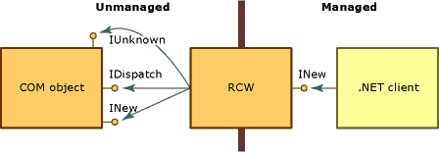

Slide 6
COM callable wrapper
A CCW is a proxy generated by the .NET runtime that enables COM clients to call .NET assemblies as though they were COM objects.
CCW exposes all public, COM-visible interfaces, data types, and return values to COM clients in a manner that is consistent with COM's enforcement of interface-based interaction. For a COM client, invoking methods on a .NET object is identical to invoking methods on a COM object.

Slide 7
